Slide 1
My Daily Core Exercises

Slide 2
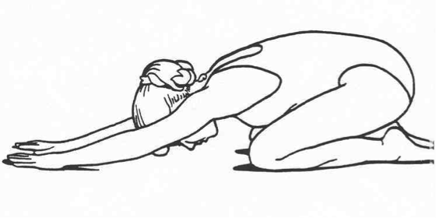
Child Pose

Slide 3
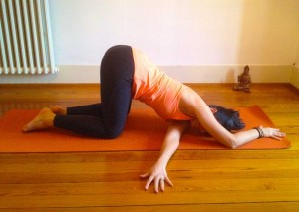
Rolling Panda

Slide 4
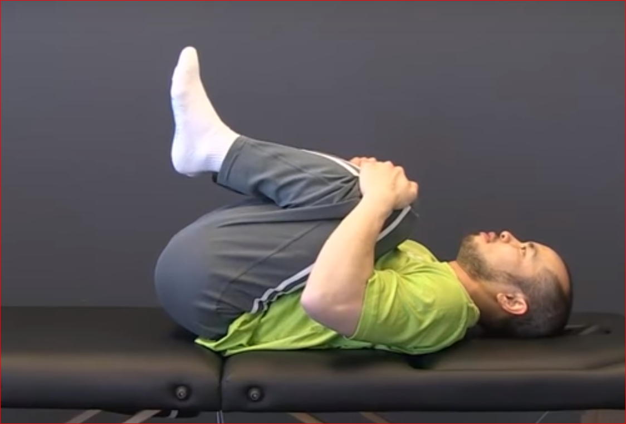
If Lying Pull Ur Knees to Chest 5-10 times

Slide 5
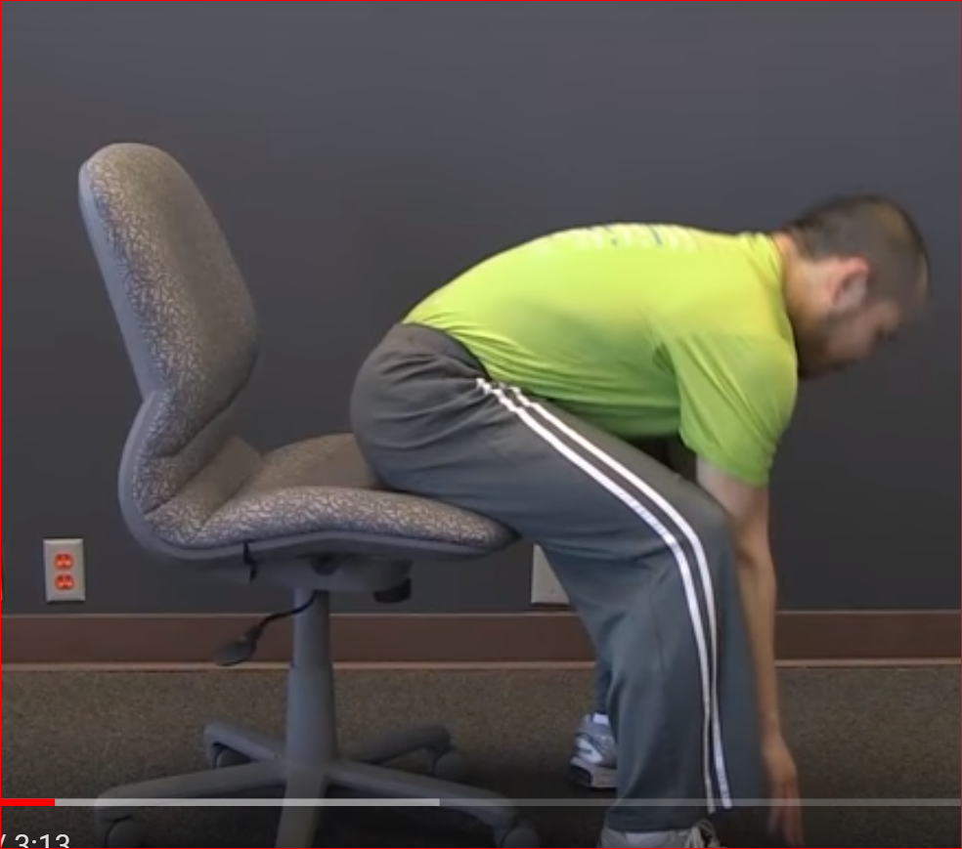
If Sitting Touch your feet 5-10 times

Slide 6
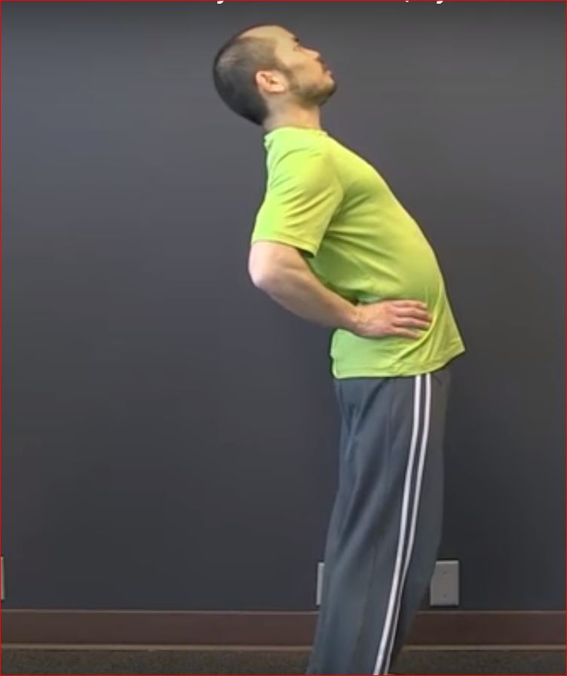
If Standing Few backward bends

Slide 7
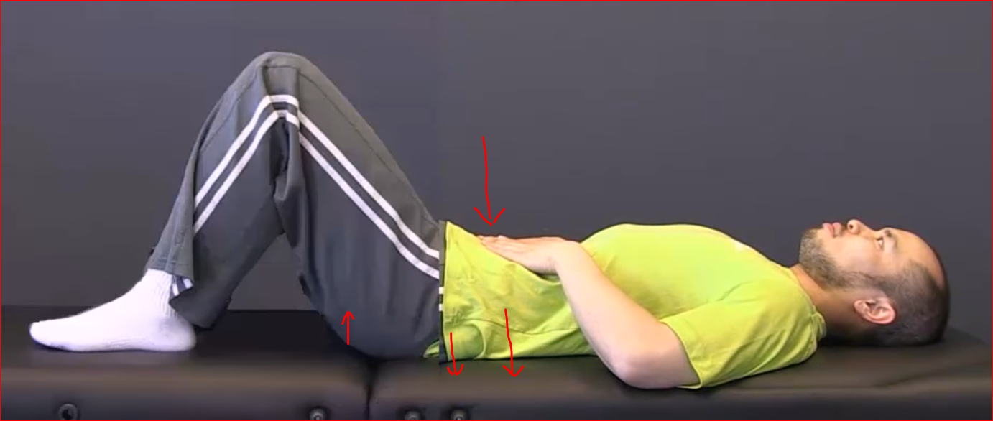
Practice Pelvic Tilt
Hold for few seconds and do again ..do another set

Slide 8
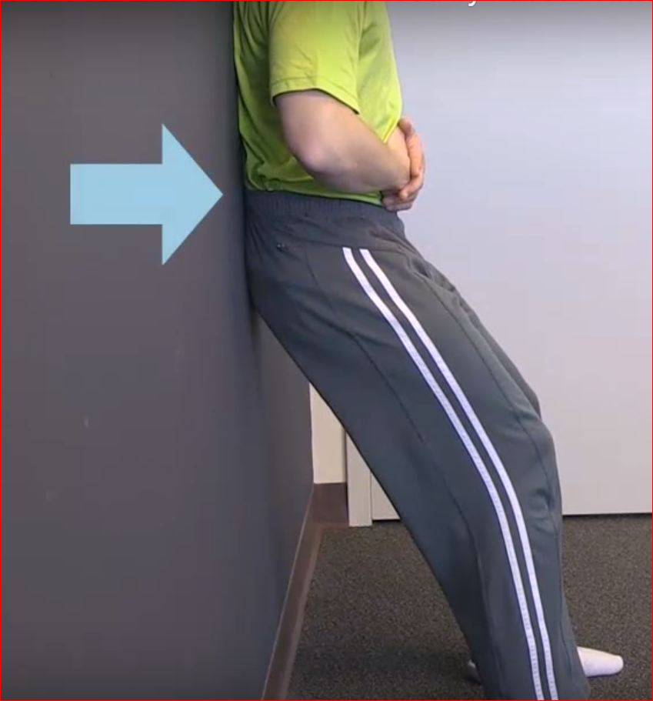

Flatten your lower back against the wall. Keeping it like that stand straight.

Slide 9
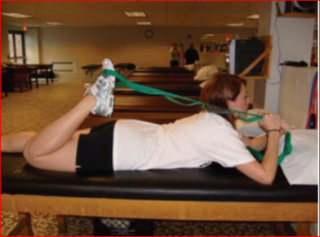
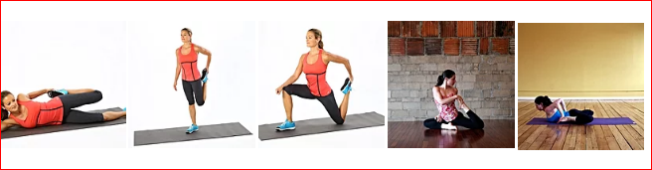
Quadriceps Stretch

Slide 10
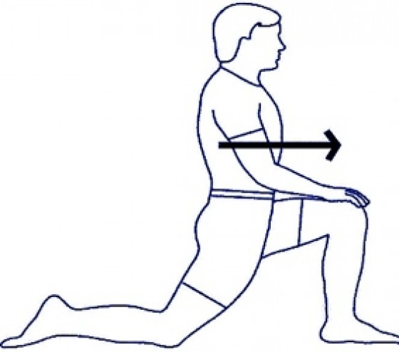
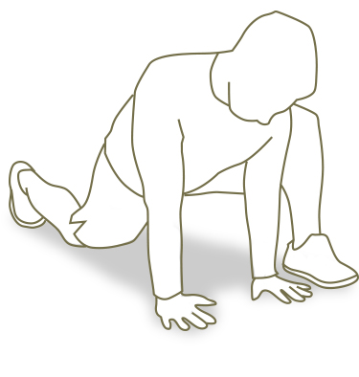
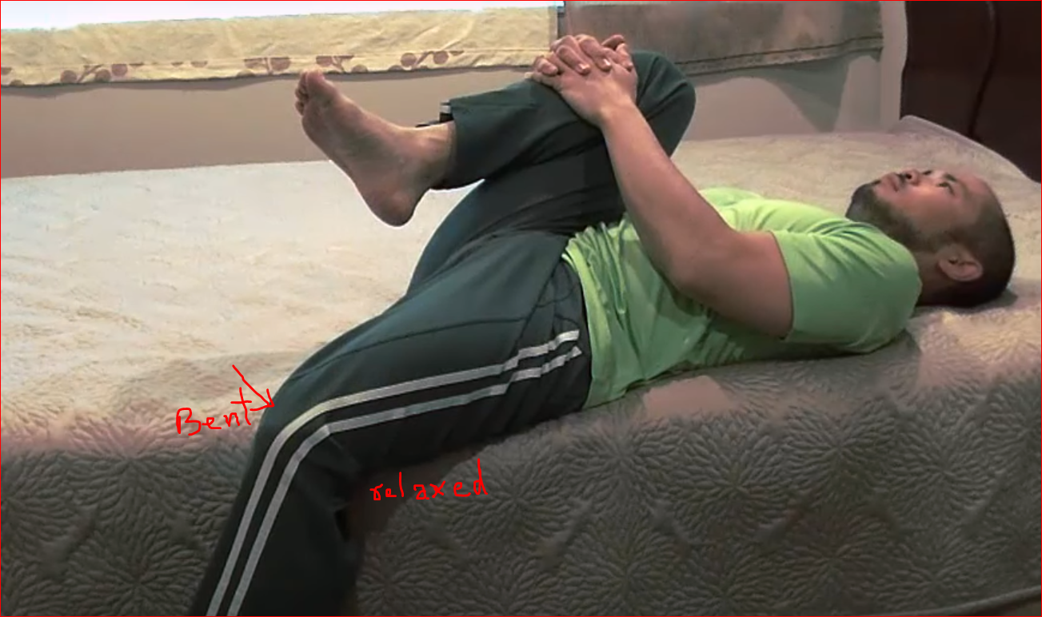
Spiderman Stretch
Hip Flexor Quad Hamstring
Hold for 2 minutes and twice a day

Slide 11
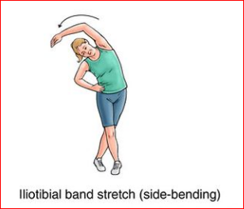
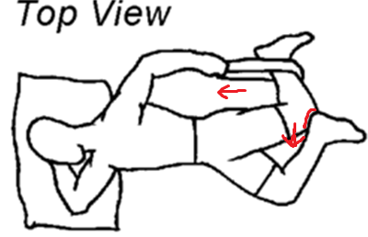
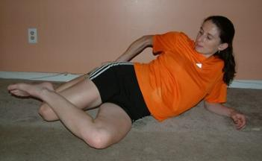
ITBand Stretch

Slide 12
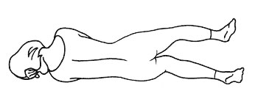
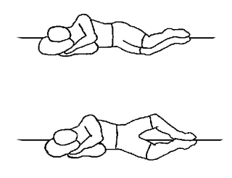
Hip Abductor Exercise
10 repetitions per side
1 time per day
4-5 days per week

Slide 13
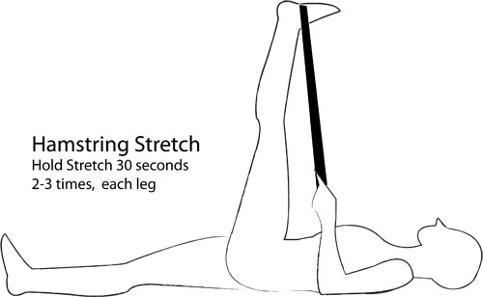
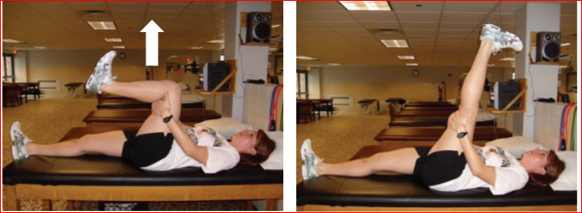
Hamstring
Repeat 15-20x each side.

Slide 14
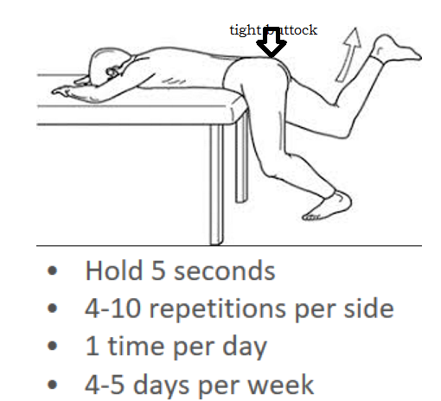
Buttock Exercise

Slide 15
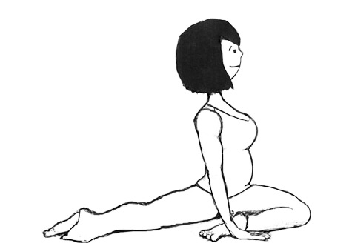
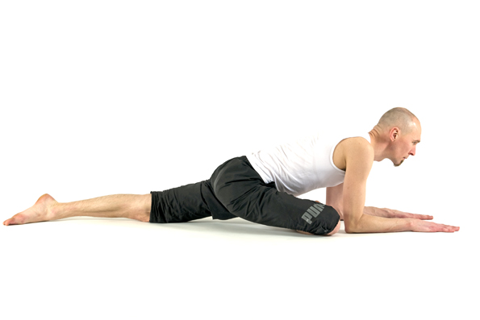
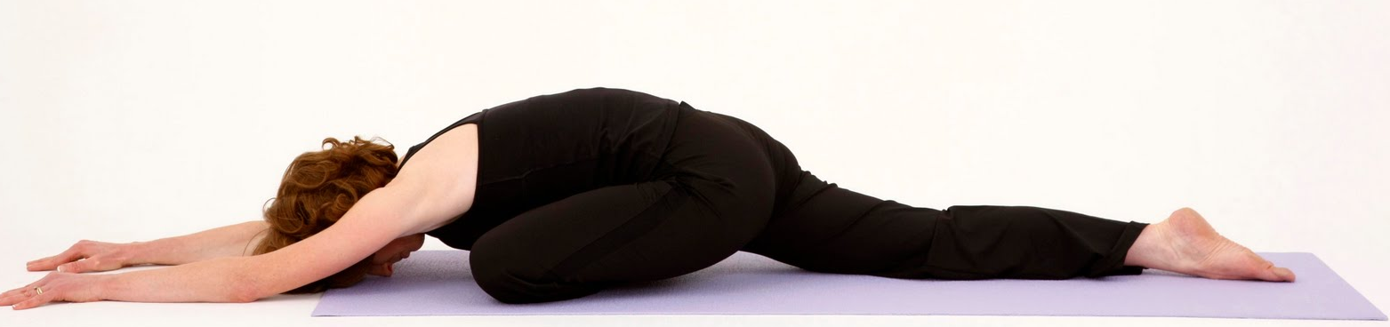
Pigeon Pose

Slide 16
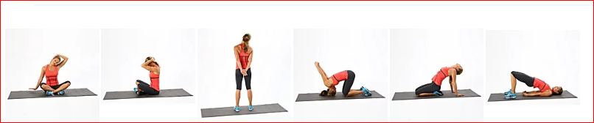
Neck Streches

Slide 17
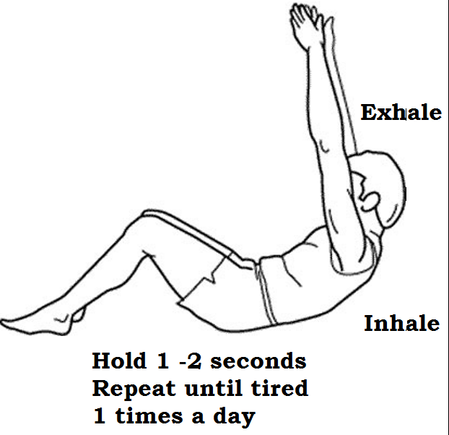
Abdominal Exercise

Slide 18
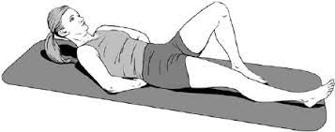
McGill Curl-up Level
Hold for 5 quick breaths

Slide 19
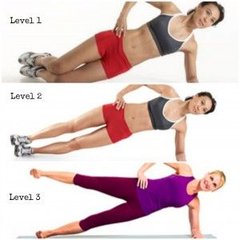
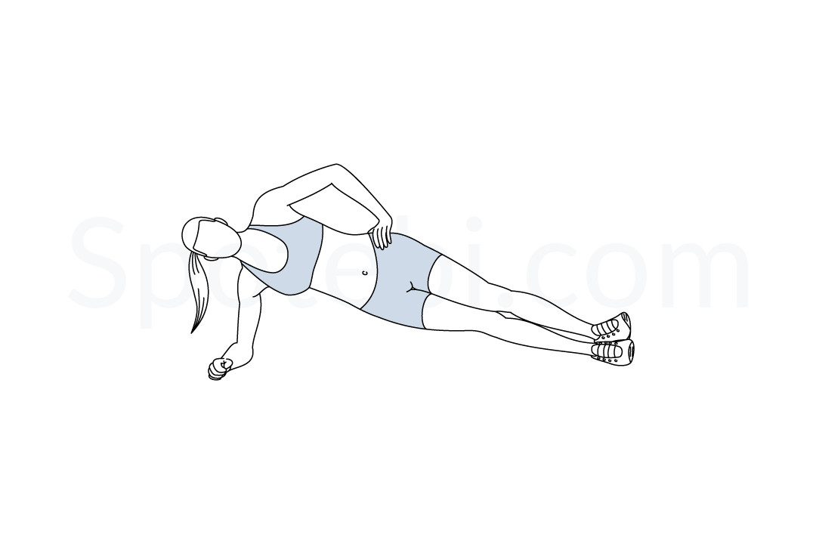
The Intermediate Side Bridge
Level 2

